Slide 1
Movement & Cutscenes
Sofia Cantu Garza

Slide 2
Movement
For the first semester, I worked on the player’s movement, including basic movement and specialized abilities.

Slide 3
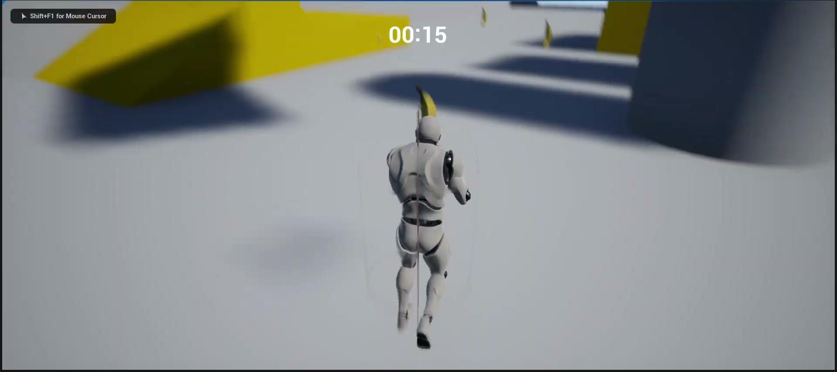
Basic Movement
Walk
Sprint
Camera Look
Crouch
Jump

Slide 4
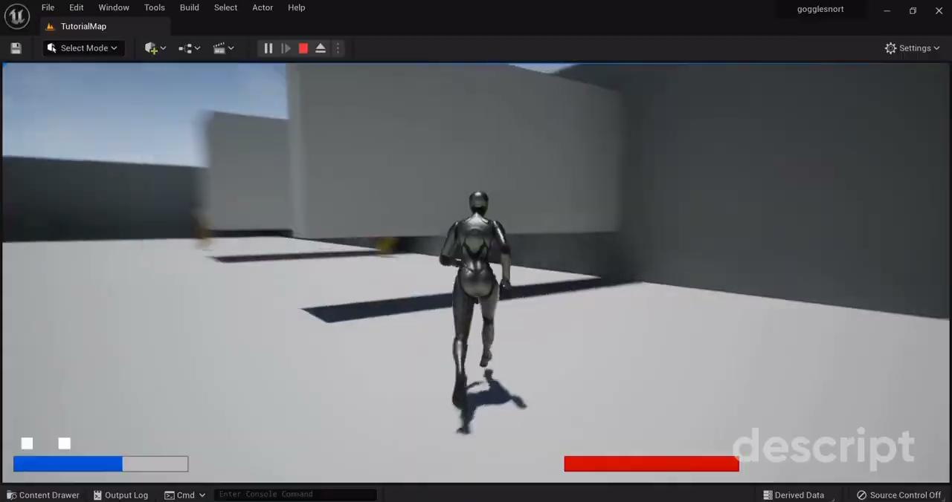
Specialized Movement
Big Jump (plus timer)
Shooting Projectiles
Slide

Slide 5
Cutscenes
In the second semester I worked on potential cutscenes for the game.

Slide 6
Cutscenes
1
2
3
Docks Map Introduction
Combat Cutscene + Banana
Industry Map Introduction
A short cutscene showing the character and introducing the docks area.
A combat cutscene featuring the player, an enemy, and a banana.
A short cutscene introducing the industry area.

Slide 7
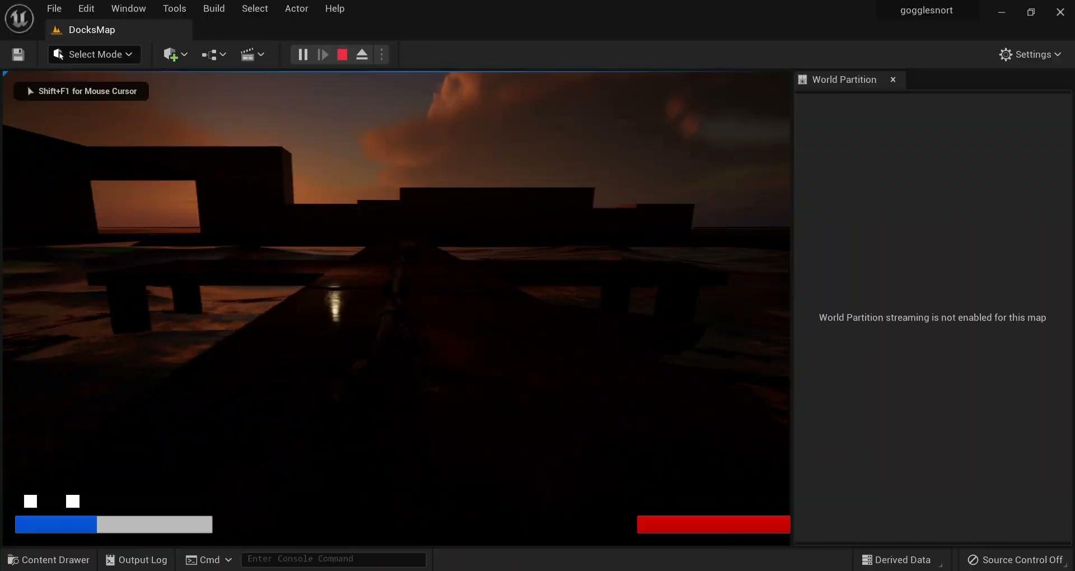

Slide 8
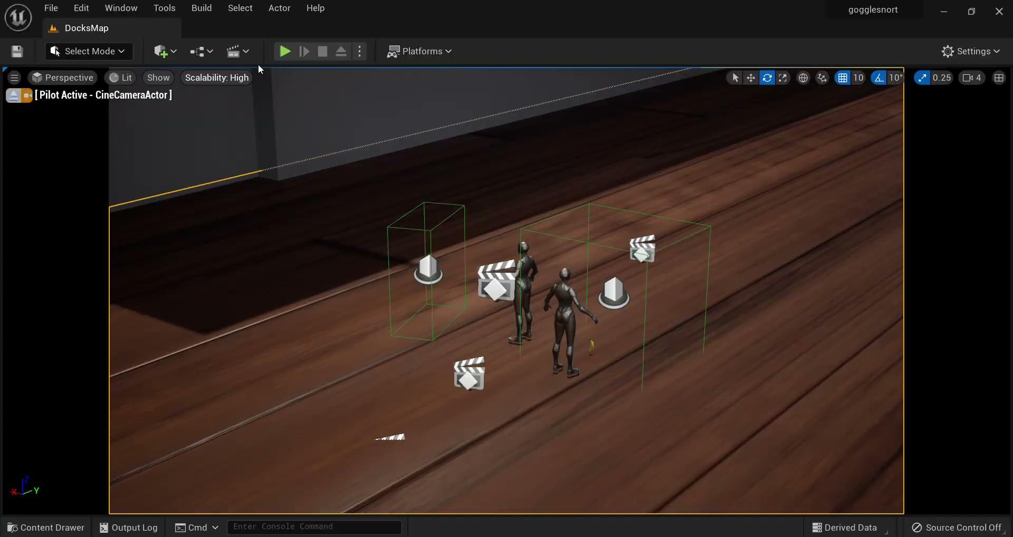

Slide 9
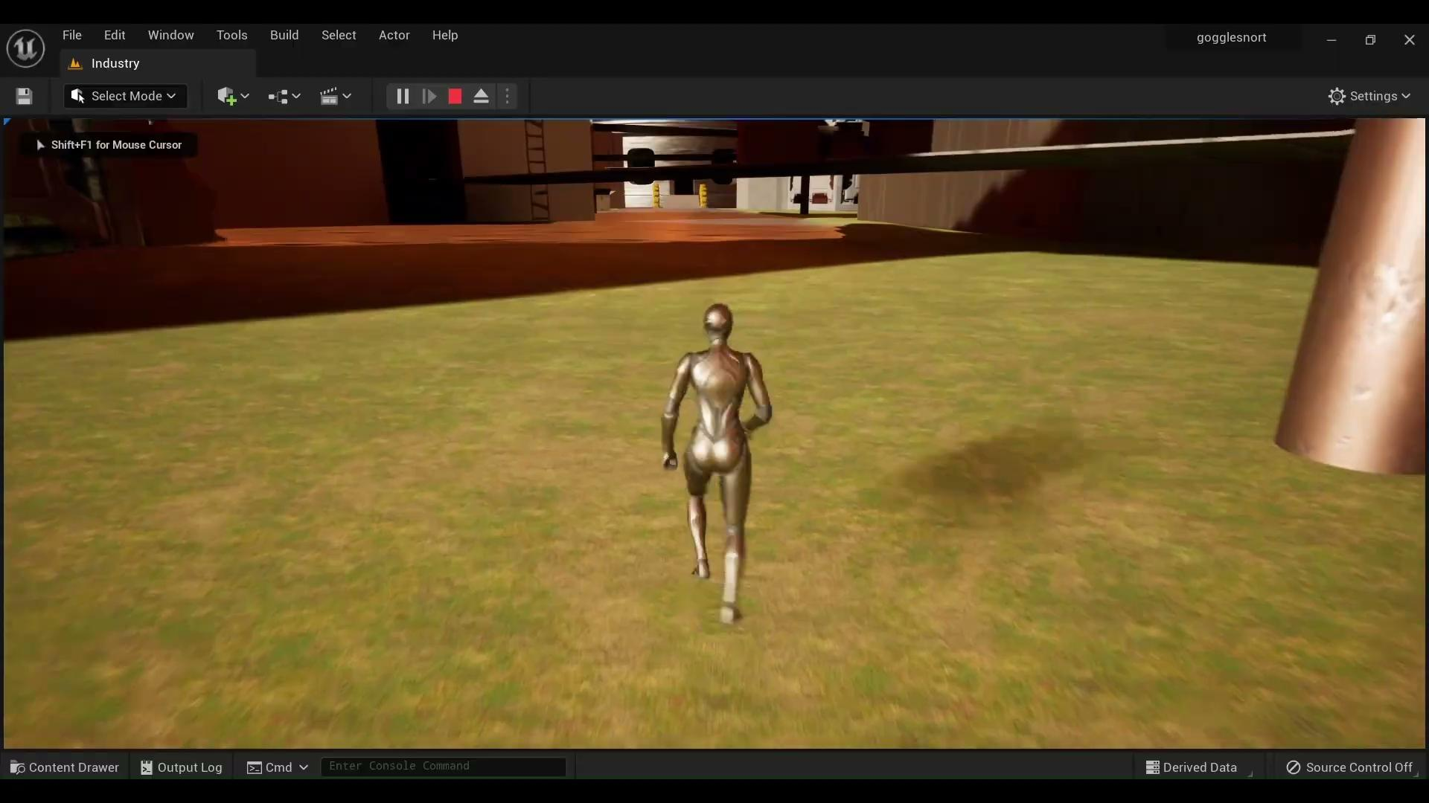

Slide 10
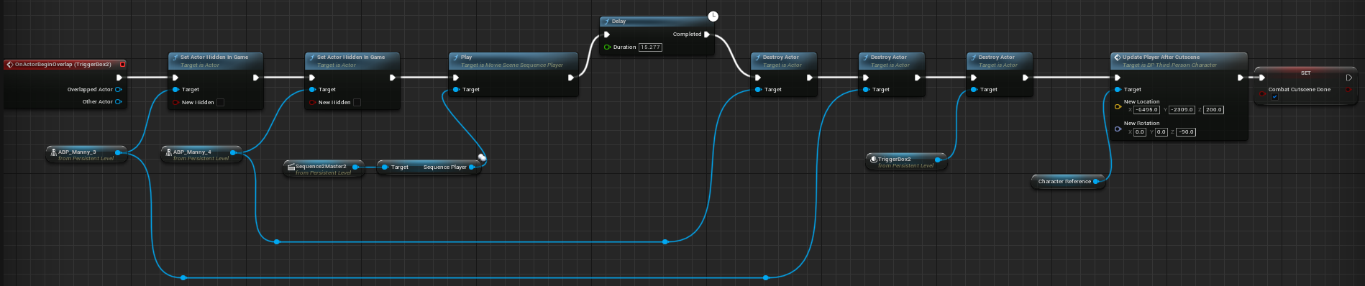
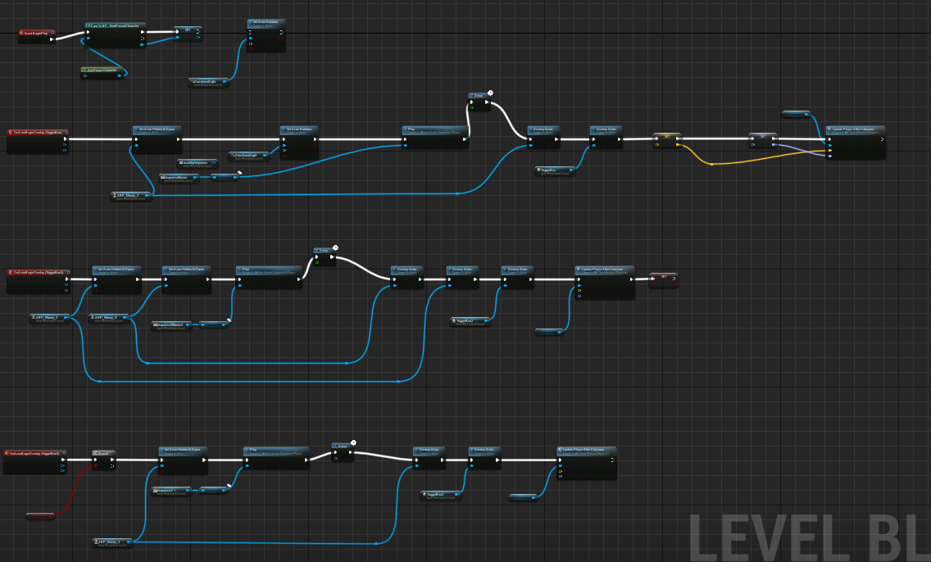
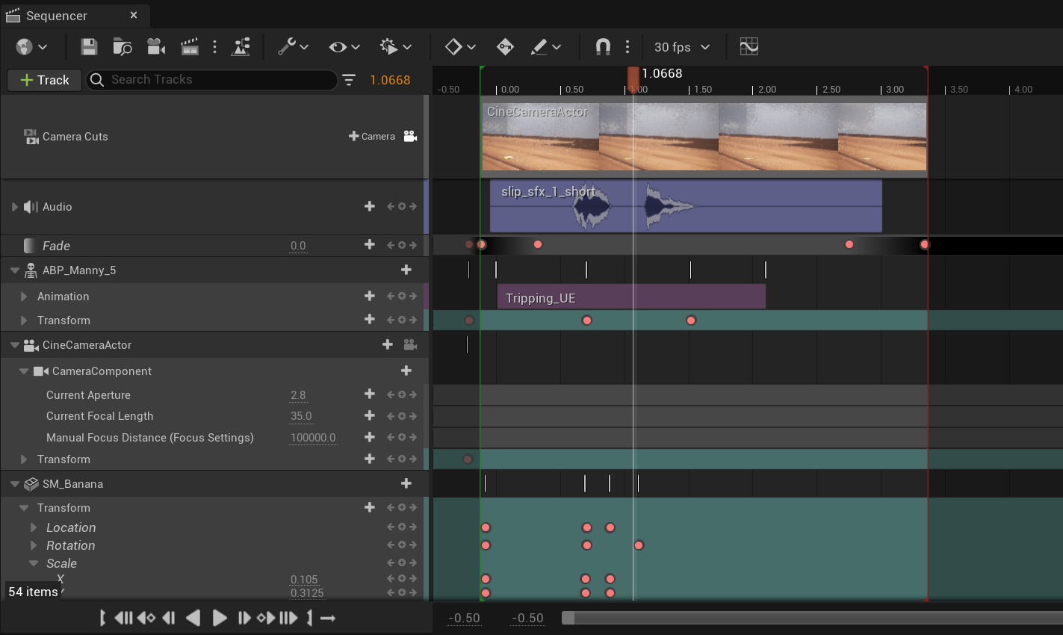

Slide 11
Thank You!

